Slide 1
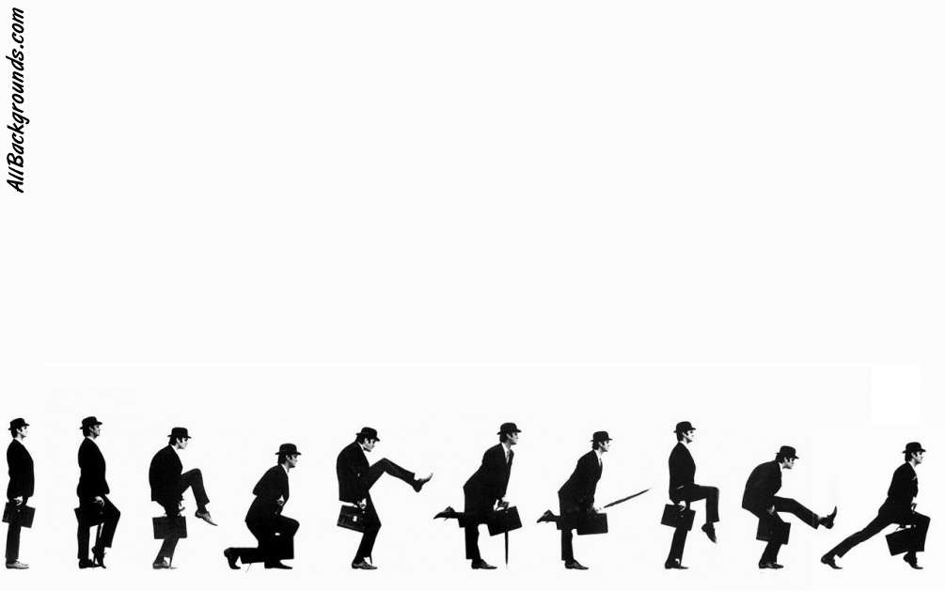
Python
Introduction to Programming
Comp07027
Lecture 13

Slide 2
More Data Structures
and
More OOP

Slide 3
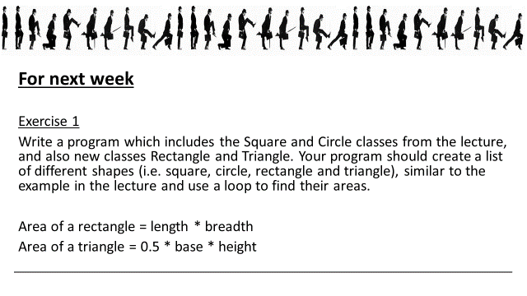
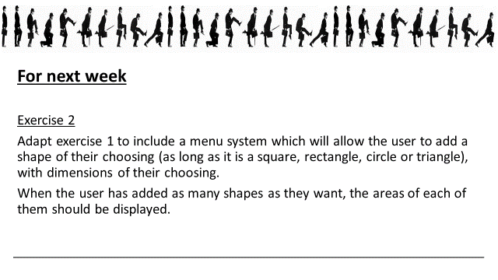
Last week’s examples

Slide 4
Last week’s examples
Let’s look at a possible partial solution to the problem.

Slide 5
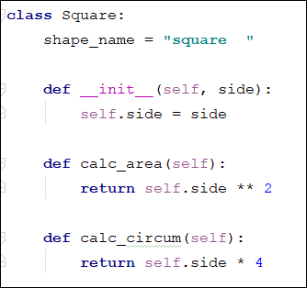
Last week’s examples
Square class with a couple of additions

Slide 6
Last week’s examples
Square class with a couple of additions
If we have a value which is EXACTLY the same for every instance of Square (in this case the name “square”) we can declare it as a constant outside __init__

Slide 7
Last week’s examples
Square class with a couple of additions
If we have a value which is EXACTLY the same for every instance of Square (in this case the name “square”) we can declare it as a constant outside __init__
The method to calculate the area of the square.

Slide 8
Last week’s examples
Square class with a couple of additions
If we have a value which is EXACTLY the same for every instance of Square (in this case the name “square”) we can declare it as a constant outside __init__
The method to calculate the area of the square.
We can add more than one method – here I’ve added a method to calculate the circumference of the square.

Slide 9
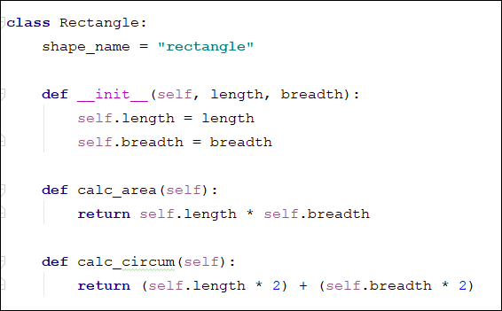
Last week’s examples
Rectangle class with a couple of additions

Slide 10
Last week’s examples
Rectangle class with a couple of additions
Rectangle is similar to Square.
I’ve added the constant shape_name

Slide 11
Last week’s examples
Rectangle class with a couple of additions
Rectangle is similar to Square.
I’ve added the constant shape_name
The method to calculate the area of the rectangle is similar to square except that it requires TWO dimensions.

Slide 12
Last week’s examples
Rectangle class with a couple of additions
Rectangle is similar to Square.
I’ve added the constant shape_name
The method to calculate the area of the rectangle is similar to square except that it requires TWO dimensions.
Calc_circum() also needs two inputs.

Slide 13
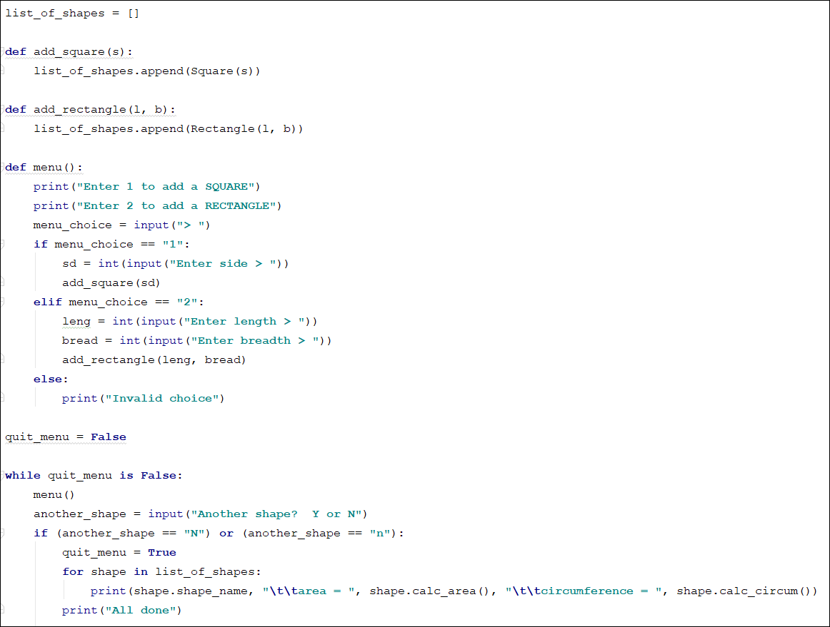
Last week’s examples
Here’s the rest of the program.
Can you see what it does?
Rectangle is similar to Square.
I’ve add the constant shape_name
The method to calculate the area of the rectangle is similar to square except that it requires TWO dimensions.
Calc_circum() also needs to inputs.

Slide 14
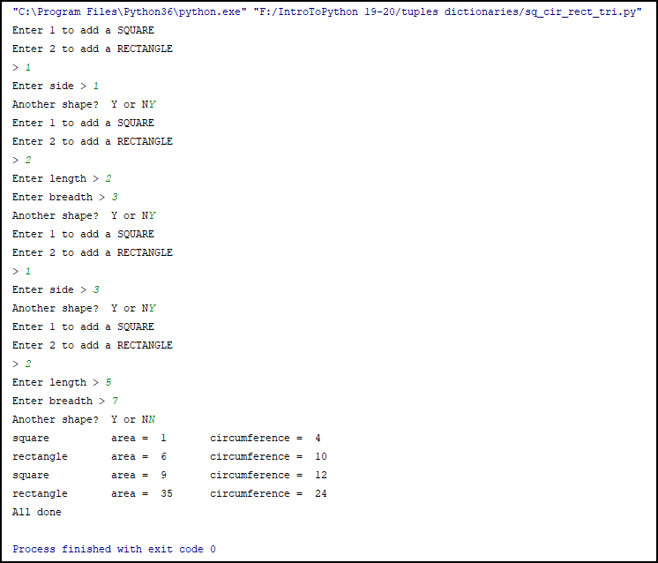
Last week’s examples
Here’s the output from the program.
This is not a definite solution to the problem but might help you see how to use OOP.
Rectangle is similar to Square.
I’ve add the constant shape_name
The method to calculate the area of the rectangle is similar to square except that it requires TWO dimensions.
Calc_circum() also needs to inputs.

Slide 15
More on Data Structures

Slide 16
Data Structures
So far we have made great use of LISTS in python (as we did in the assessment and the previous example).
However, there are others and we’re now going to have a look at a couple of them – TUPLES and DICTIONARIES.

Slide 17
Tuple
A Tuple is like a List.
The difference is that a tuple cannot be changed, so we tend to use tuples when we want to create a list of elements that are set. Tuples takes less time to process.
Tuples are said to be immutable (can’t be changed)

Slide 18
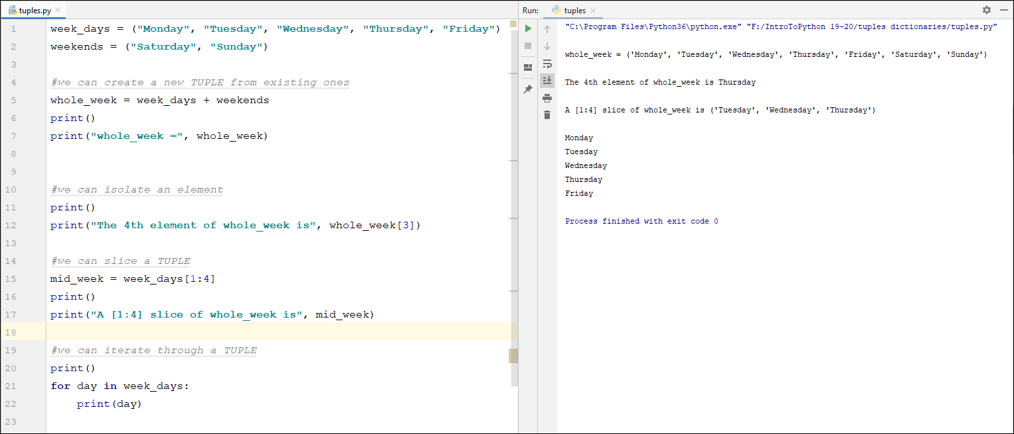
Tuples are immutable (can’t be changed) so we use them to store elements that won’t change – like the days of the week, the colours of the rainbow etc
Tuple

Slide 19
Tuples are immutable (can’t be changed) so we use them to store elements that won’t change – like the days of the week, the colours of the rainbow etc
Tuple
Tuples can still be manipulated.
We can concatenate (add) them, we can pick out a single element, (or a slice).
We can also use them as a range of values to be iterated through.
We just can’t change them.

Slide 20
Tuple
Notice: round brackets ()

Slide 21
Tuple

Slide 22
Tuple

Slide 23
Dictionary
Lists (and tuples) use numbers as indices e.g. the_pythons is a list and
the_pythons[2] = Gilliam
So, the_pythons connects:
0 to “Chapman”
1 to “Cleese”
2 to “Gilliam”
3 to “Idle” etc

Slide 24
Dictionary
A Dictionary is also like a List.
However, in a dictionary we can connect any two types.
That can be very useful.

Slide 25
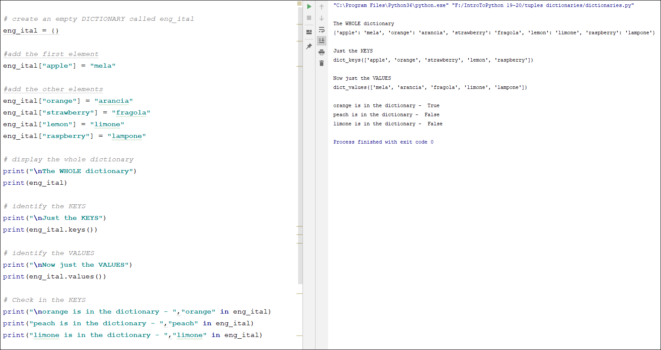
Dictionary
Dictionaries allow us to associate any two types (the index or KEY doesn’t have to be a number).
Here we associate a word in English with the corresponding word in Italian (exactly what you’d expect an English-Italian dictionary to do!).

Slide 26
Dictionary
Dictionaries allow us to associate any two types (the index or KEY doesn’t have to be a number).
Here we associate a word in English with the corresponding word in Italian (exactly what you’d expect an English-Italian dictionary to do!).
Dictionaries are made up of KEYS and VALUES.
In this example the English words are the KEYS and the Italian words are the VALUES.

Slide 27
Dictionary
So, eng_ital connects:
KEY to VALUE
apple to mela
orange to arancia
strawberry to fragola
lemon to limone
raspberry to lampone

Slide 28
We begin by creating an empty dictionary eng_ital. = {} curly brackets{}
Dictionary
Here are some things we can do with a Dictionary

Slide 29
We begin by creating an empty dictionary eng_ital. = {} curly brackets{}
Now we populate the dictionary with ordered pairs of elements.
The KEY in square brackets [] is paired with its Italian VALUE.
Dictionary
Here are some things we can do with a Dictionary

Slide 30
We begin by creating an empty dictionary eng_ital. = {} curly brackets{}
Now we populate the dictionary with ordered pairs of elements.
The KEY in square brackets [] is paired with its Italian VALUE.
Dictionary
Here are some things we can do with a Dictionary
We can print the whole dictionary, Keys and Values ….

Slide 31
We begin by creating an empty dictionary eng_ital. = {} curly brackets{}
Now we populate the dictionary with ordered pairs of elements.
The KEY in square brackets [] is paired with its Italian VALUE.
Dictionary
Here are some things we can do with a Dictionary
We can print the whole dictionary, Keys and Values ….

Slide 32
We begin by creating an empty dictionary eng_ital. = {} curly brackets{}
Now we populate the dictionary with ordered pairs of elements.
The KEY in square brackets [] is paired with its Italian VALUE.
Dictionary
Here are some things we can do with a Dictionary
We can print the whole dictionary, Keys and Values ….
.. or just the Keys ….

Slide 33
We begin by creating an empty dictionary eng_ital. = {} curly brackets{}
Now we populate the dictionary with ordered pairs of elements.
The KEY in square brackets [] is paired with its Italian VALUE.
Dictionary
Here are some things we can do with a Dictionary
We can print the whole dictionary, Keys and Values ….
.. or just the Keys ….

Slide 34
We begin by creating an empty dictionary eng_ital. = {} curly brackets{}
Now we populate the dictionary with ordered pairs of elements.
The KEY in square brackets [] is paired with its Italian VALUE.
Dictionary
Here are some things we can do with a Dictionary
We can print the whole dictionary, Keys and Values ….
.. or just the Keys ….
.. or just the Values.

Slide 35
We begin by creating an empty dictionary eng_ital. = {} curly brackets{}
Now we populate the dictionary with ordered pairs of elements.
The KEY in square brackets [] is paired with its Italian VALUE.
Dictionary
Here are some things we can do with a Dictionary
We can print the whole dictionary, Keys and Values ….
.. or just the Keys ….
.. or just the Values.

Slide 36
We begin by creating an empty dictionary eng_ital. = {} curly brackets{}
Now we populate the dictionary with ordered pairs of elements.
The KEY in square brackets [] is paired with its Italian VALUE.
Dictionary
Here are some things we can do with a Dictionary
We can print the whole dictionary, Keys and Values ….
.. or just the Keys ….
.. or just the Values.
We can also check if the dictionary contains a key.

Slide 37
We begin by creating an empty dictionary eng_ital. = {} curly brackets{}
Now we populate the dictionary with ordered pairs of elements.
The KEY in square brackets [] is paired with its Italian VALUE.
Dictionary
Here are some things we can do with a Dictionary
We can print the whole dictionary, Keys and Values ….
.. or just the Keys ….
.. or just the Values.
We can also check if the dictionary contains a key.

Slide 38
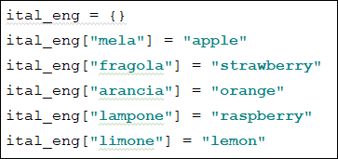
Dictionary
Here is the Italian to English version.

Slide 39
Dictionary
Here is the Italian to English version.
Or you can do this

Slide 40
Dictionary
Let’s revisit a previous program – the car example – and see if we can incorporate one of our new data structures.

Slide 41
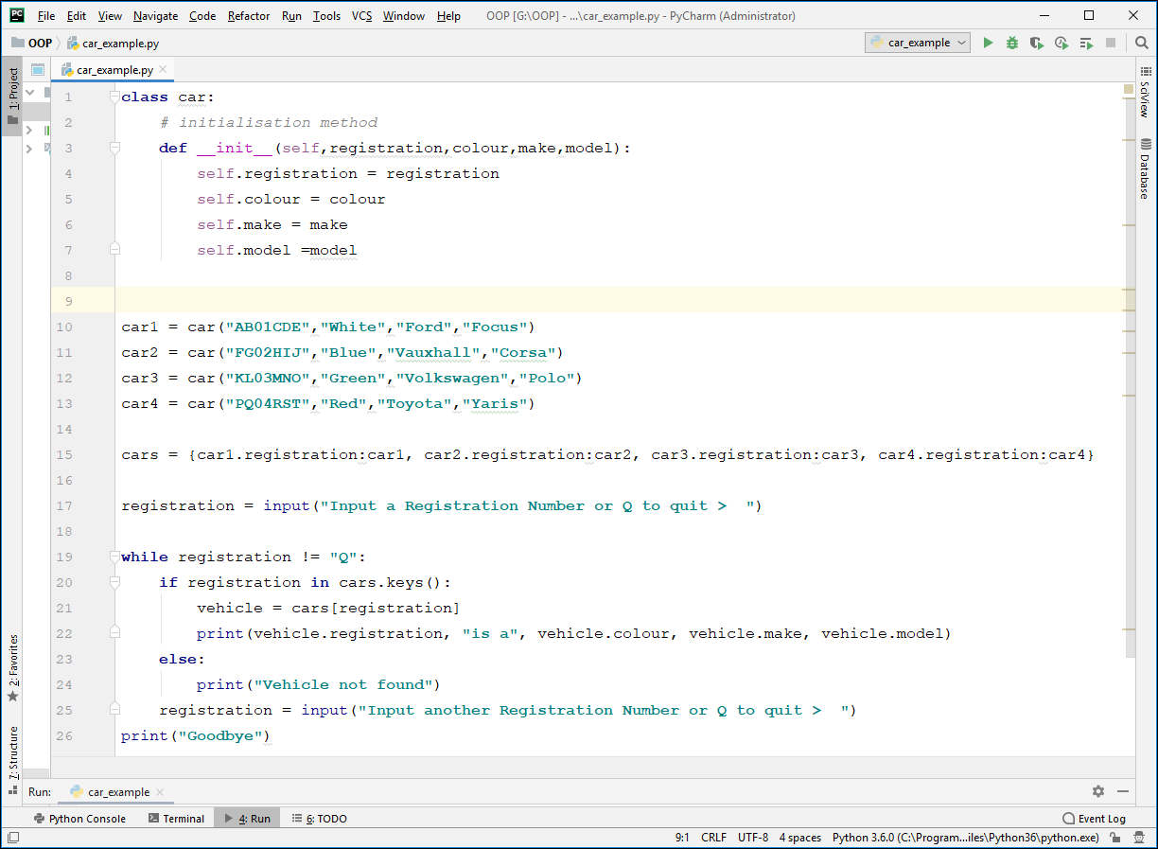
Car Example
We created a car Class, and used that to create four instances of car.

Slide 42
Dictionary
Remember, in a Dictionary, we can connect any two types.
So
cars = {car1.registration:car1, car2.registration:car2,
car3.registration:car3, car4.registration:car4}
gives us a Dictionary of all the details of each car (e.g. car1) with its registration number (car1.registration) as the unique key.

Slide 43
Dictionary
So, this dictionary connects:
Key Value
car1.registration to car1
car2.registration to car2
car3.registration to car3
car4.registration to car4

Slide 44
Dictionary
We can now add some more code to the program to allow us to prompt for and accept a registration number, search for it and display all the attributes of that car (if it finds it!)

Slide 45
Dictionary

Slide 47
For next week
Create a program to store the details of flights (min of 6 flights) e.g.
Flight Number Airline Leaving from Going to
FR5771 Ryanair Glasgow Dublin
KL1473 KLM Amsterdam Glasgow
EK023 Emirates Dubai Edinburgh
EZY6907 EasyJet Edinburgh Geneva
The program should be able to search for a flight number and display all the details of that flight, if the flight number is valid.

Slide 48
Questions??

